Slide 1


LIFE SKILLS
GRADE 2
YEAR 1
BEGINNING KNOWLEDGE AND PERSONAL AND SOCIAL WELLBEING

Slide 2
OUTLINE
DURATION | CONTENT AREA
Week 1 & 2 | Seasons
Week 3 & 4 | Creatures living in water, Ocean, River and Pond
Week 5, 6 & 7 | Animals and their shelters
Week 8 & 9 | Farm and wild animals

Slide 3
LESSON OBJECTIVES
The learner must be able to:
Name four seasons
Discuss how seasons affect our - clothes, food and activities
Understand how seasons affect growing things - sowing, growing and harvesting
Discuss how seasons affect animals - include farming e.g., sheep shearing, animal dipping; birds e.g. migration and nesting

Slide 4
WEEK 1 & 2
SEASONS

Slide 5
ASSEESSMENT GOALS
Name the four seasons
Know how seasons affect our clothes/food and activities

Slide 6

SEASONS

Slide 7


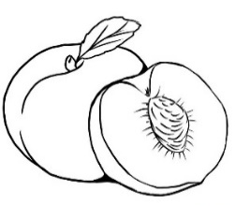
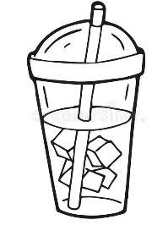

GROUP 1
Task 1: Colour the food pictures that you will eat during summer and winter
Summer | Ice cream peaches cold drink Milo

Slide 8
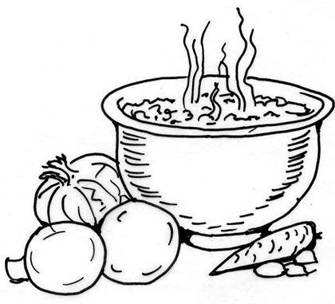
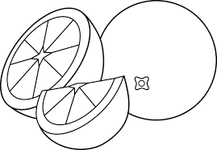
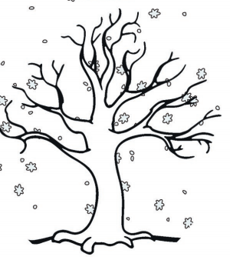


Task 1 cont…
Winter | soup oranges Chrismas pudding Hot chocolate

Slide 9
GROUP 1
Task 2: Cut, match and paste the clothes to wear during the seasons

Slide 10
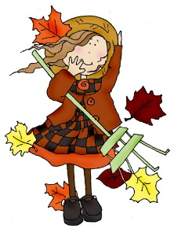
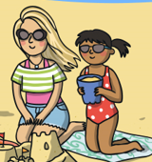

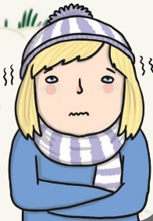
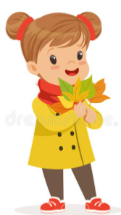
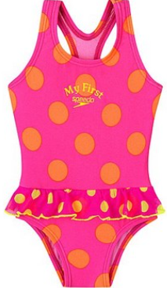
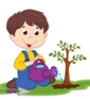
Task 2 cont…
Cut the pictures and paste in the correct spaces on the previous page
 ---------------------------------------------------------------------------------------------------------------------------

Slide 11
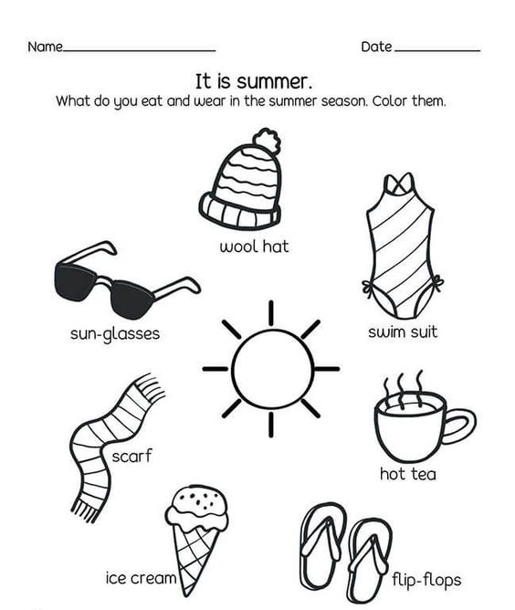
Group 2
Task 1: What do you eat and wear in the summer season. Colour them

Slide 12
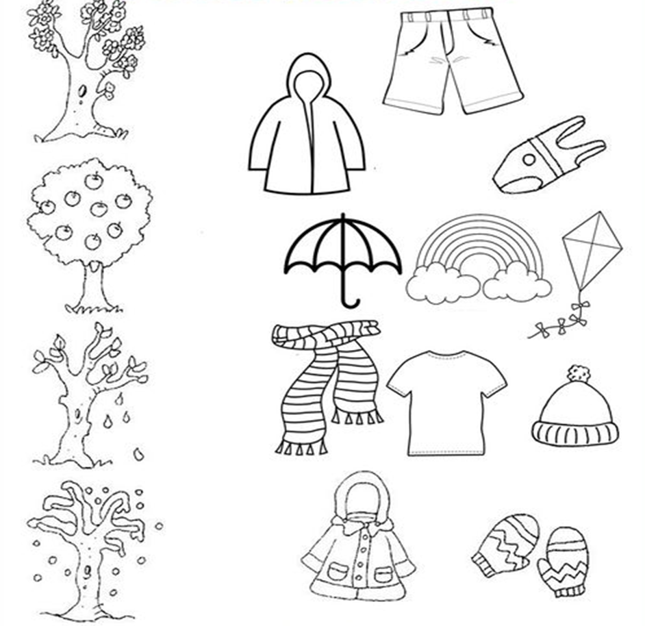
GROUP 2
Task 2: Match the following pictures with the correct season.

Slide 13
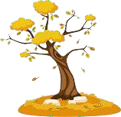

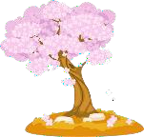
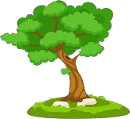

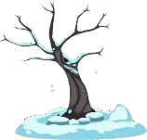
GROUP 3
Task 1: Match the seasons to the pictures.
Spring
Autumn

Slide 14
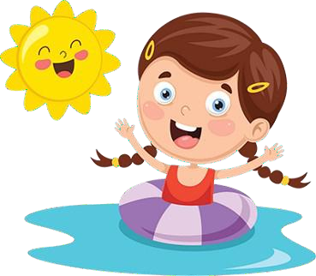
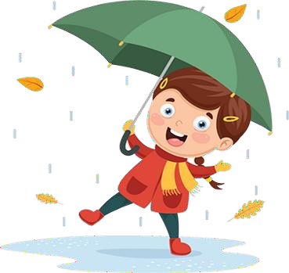
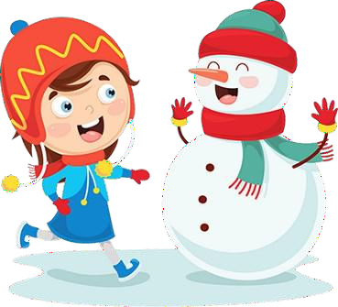
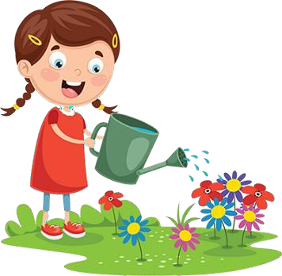
Group 3
Task 2: Write the word for the season shown.
Spring Autumn Winter Summer

Slide 15
WEEK 3 & 4
CREATURES LIVING IN WATER, OCEAN, RIVER AND POND

Slide 16
LESSONS OBJECTIVES
The learner must be able to:
Compare salt/fresh water
Identify land animals (All animals done up to now)
Identify water animals - River - e.g. fish, crocodile, hippo, crabs, Ponds and dams - e.g. fish, frog, dragonfly, Salt water - Sea - e.g. fish - shark, dolphin
Compare characteristics of land animals with water animals

Slide 17
ASSESSMENT GAOLS
Compare salt and fresh water
Identify and label land animals
Identify and label water animals, e.g. fish/crocodile/ hippo/crabs/frog/dragonfly /shark/dolphin

Slide 18
CREATURES LIVING IN WATER, OCEAN, RIVER AND POND

Slide 19
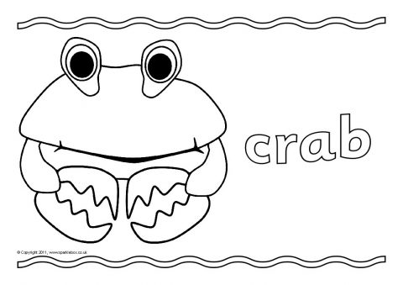
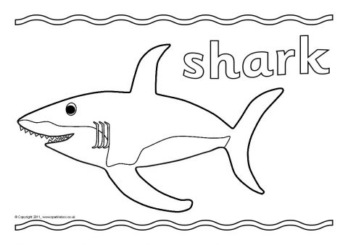
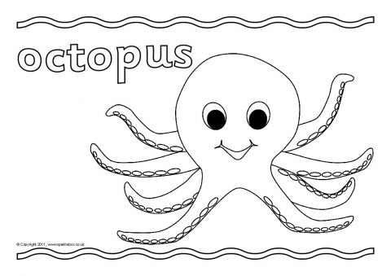
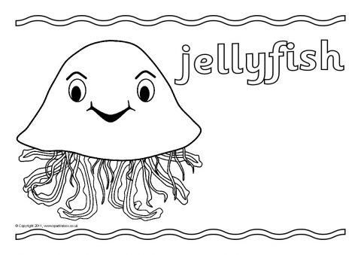
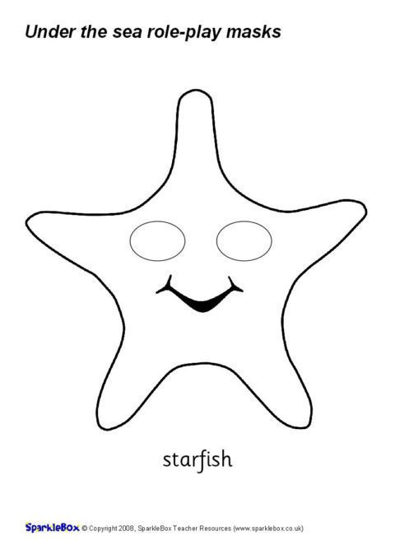
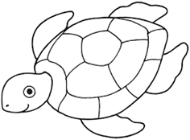
GROUP 1
Task 1: Colour the animals that live in the ocean.
Starfish
Sea turtle

Slide 20
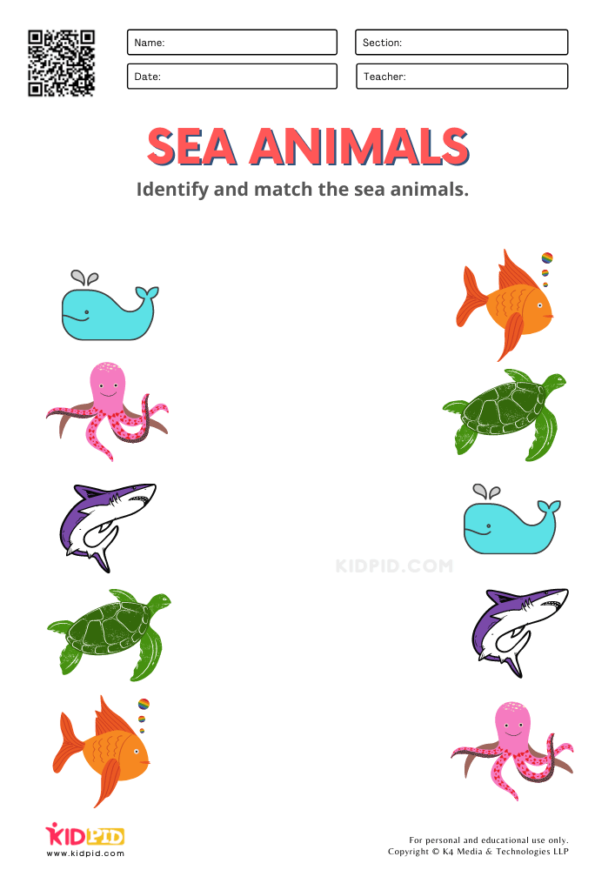
GROUP 1
Task 1: Match the sea animals.

Slide 21
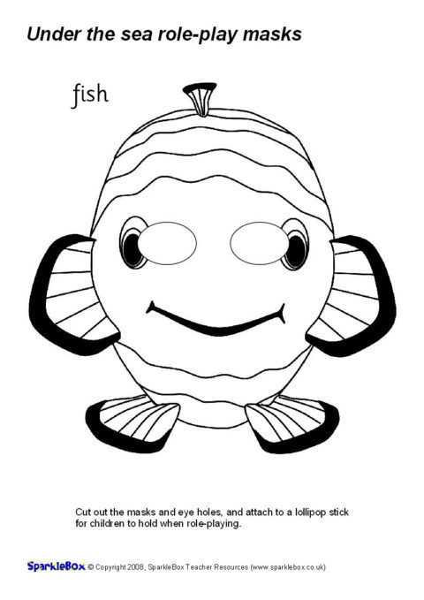
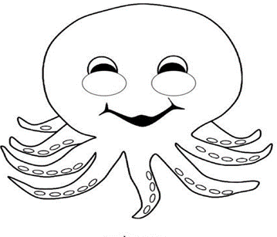
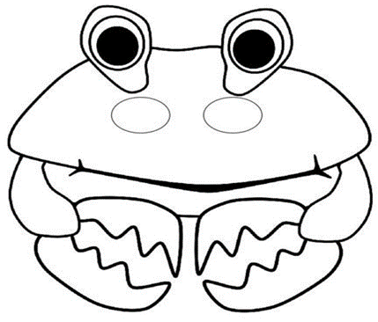
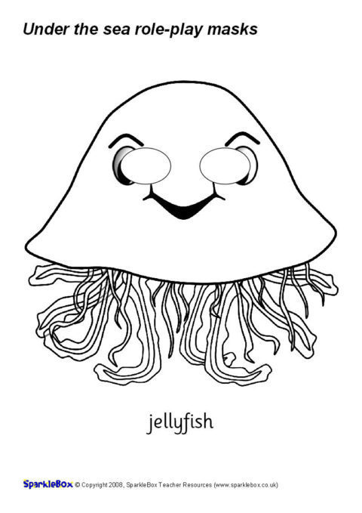
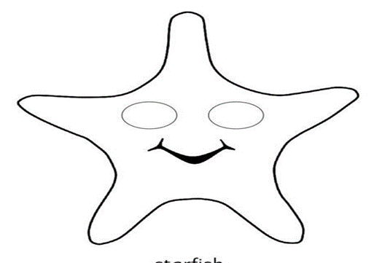
GROUP 2
Task 1: Colour and trace the animals that live in the ocean.
fish | octopus | crab
Sea turtle | jellyfish | starfish

Slide 22
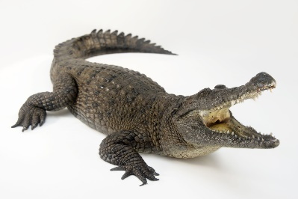
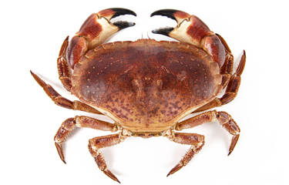
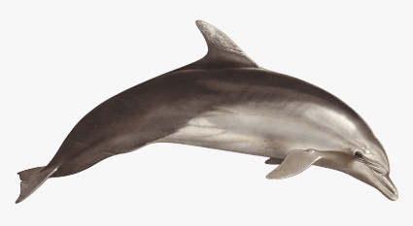
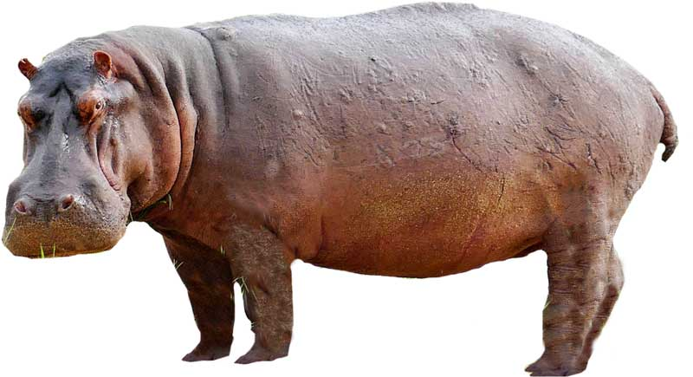
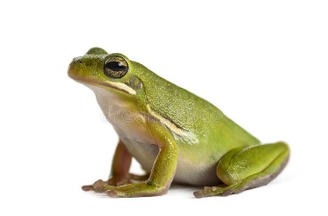
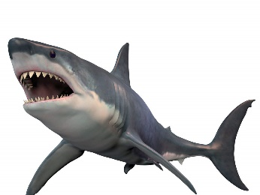
GROUP 3
Task 2: Identify and label water animals. Use the words in the word box.

Slide 23
Task 1 cont…
dolphin | frog | crab
shark | crocodile | hippopotamus

Slide 24
GROUP 3
Task 2: Draw your favourite water animals.

Slide 25
WEEK 5, 6 & 7
Animals and their shelters

Slide 26
LESSON OBJECTIVES
The learner must be able to:
Identify animals and creatures that make their homes - such as birds, some bees, ants, spiders etc.
Identify animals and creatures that find their homes - such as baboons, snakes, squirrels etc.
Identify animals and creatures that carry their homes - such as snails, tortoises etc.

Slide 27
ASSESSMENT GOALS
Identify animals and creatures that make own homes - such as birds, some bees, ants, spiders etc.
Identify animals and creatures that find their homes - such as baboons, snakes, squirrels etc.
Identify animals and creatures that carry their homes - such as snails, tortoises etc.

Slide 28
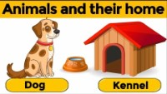
ANIMALS AND THEIR SHELTERS

Slide 29
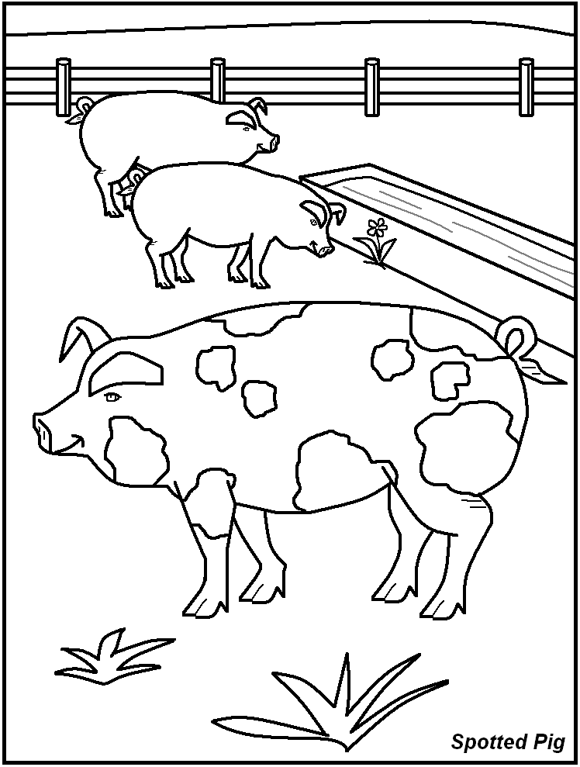
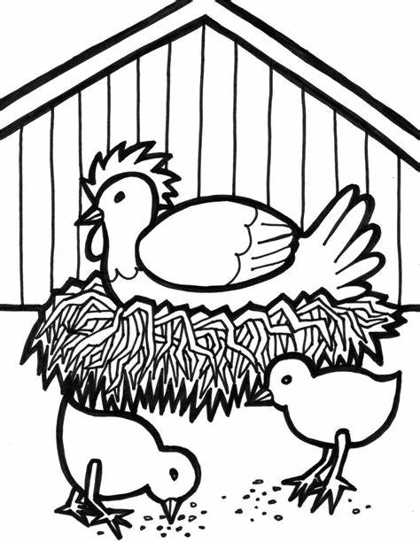
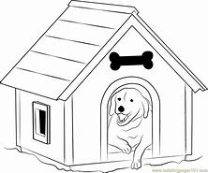
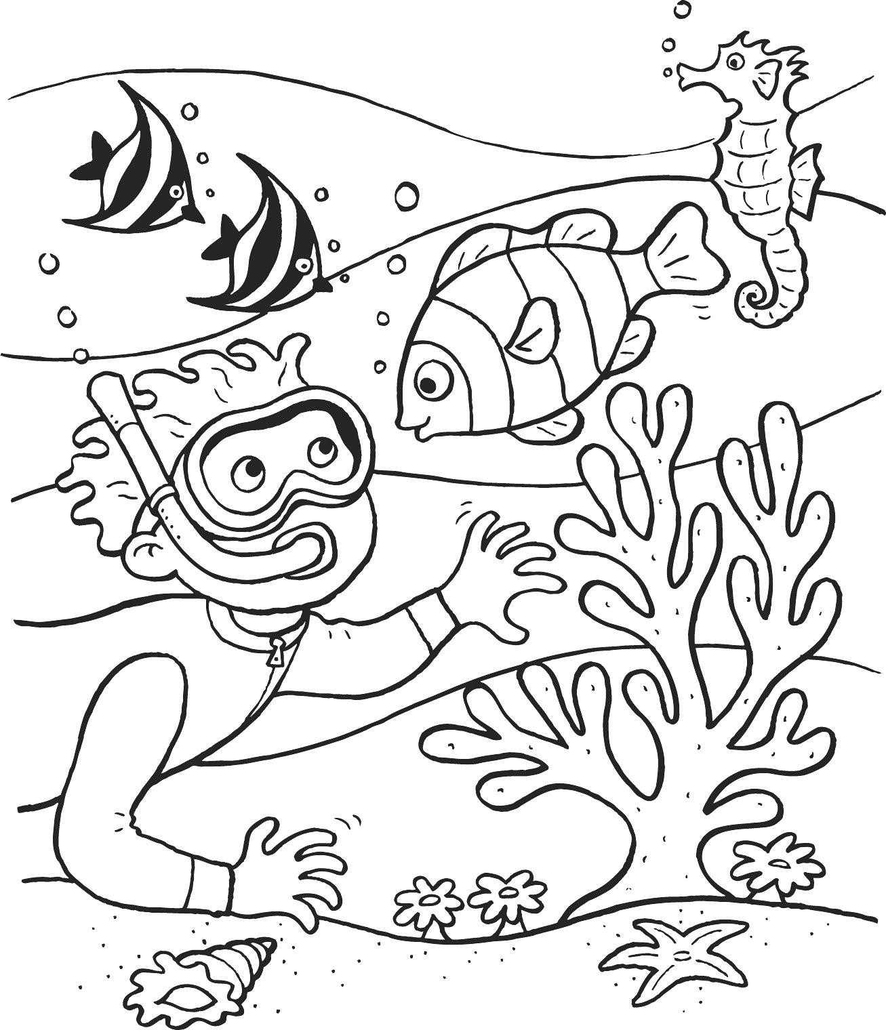
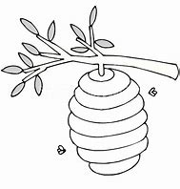
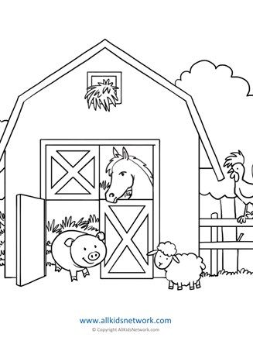
Group 1
Task 1: Colour the animal homes below.

Slide 30
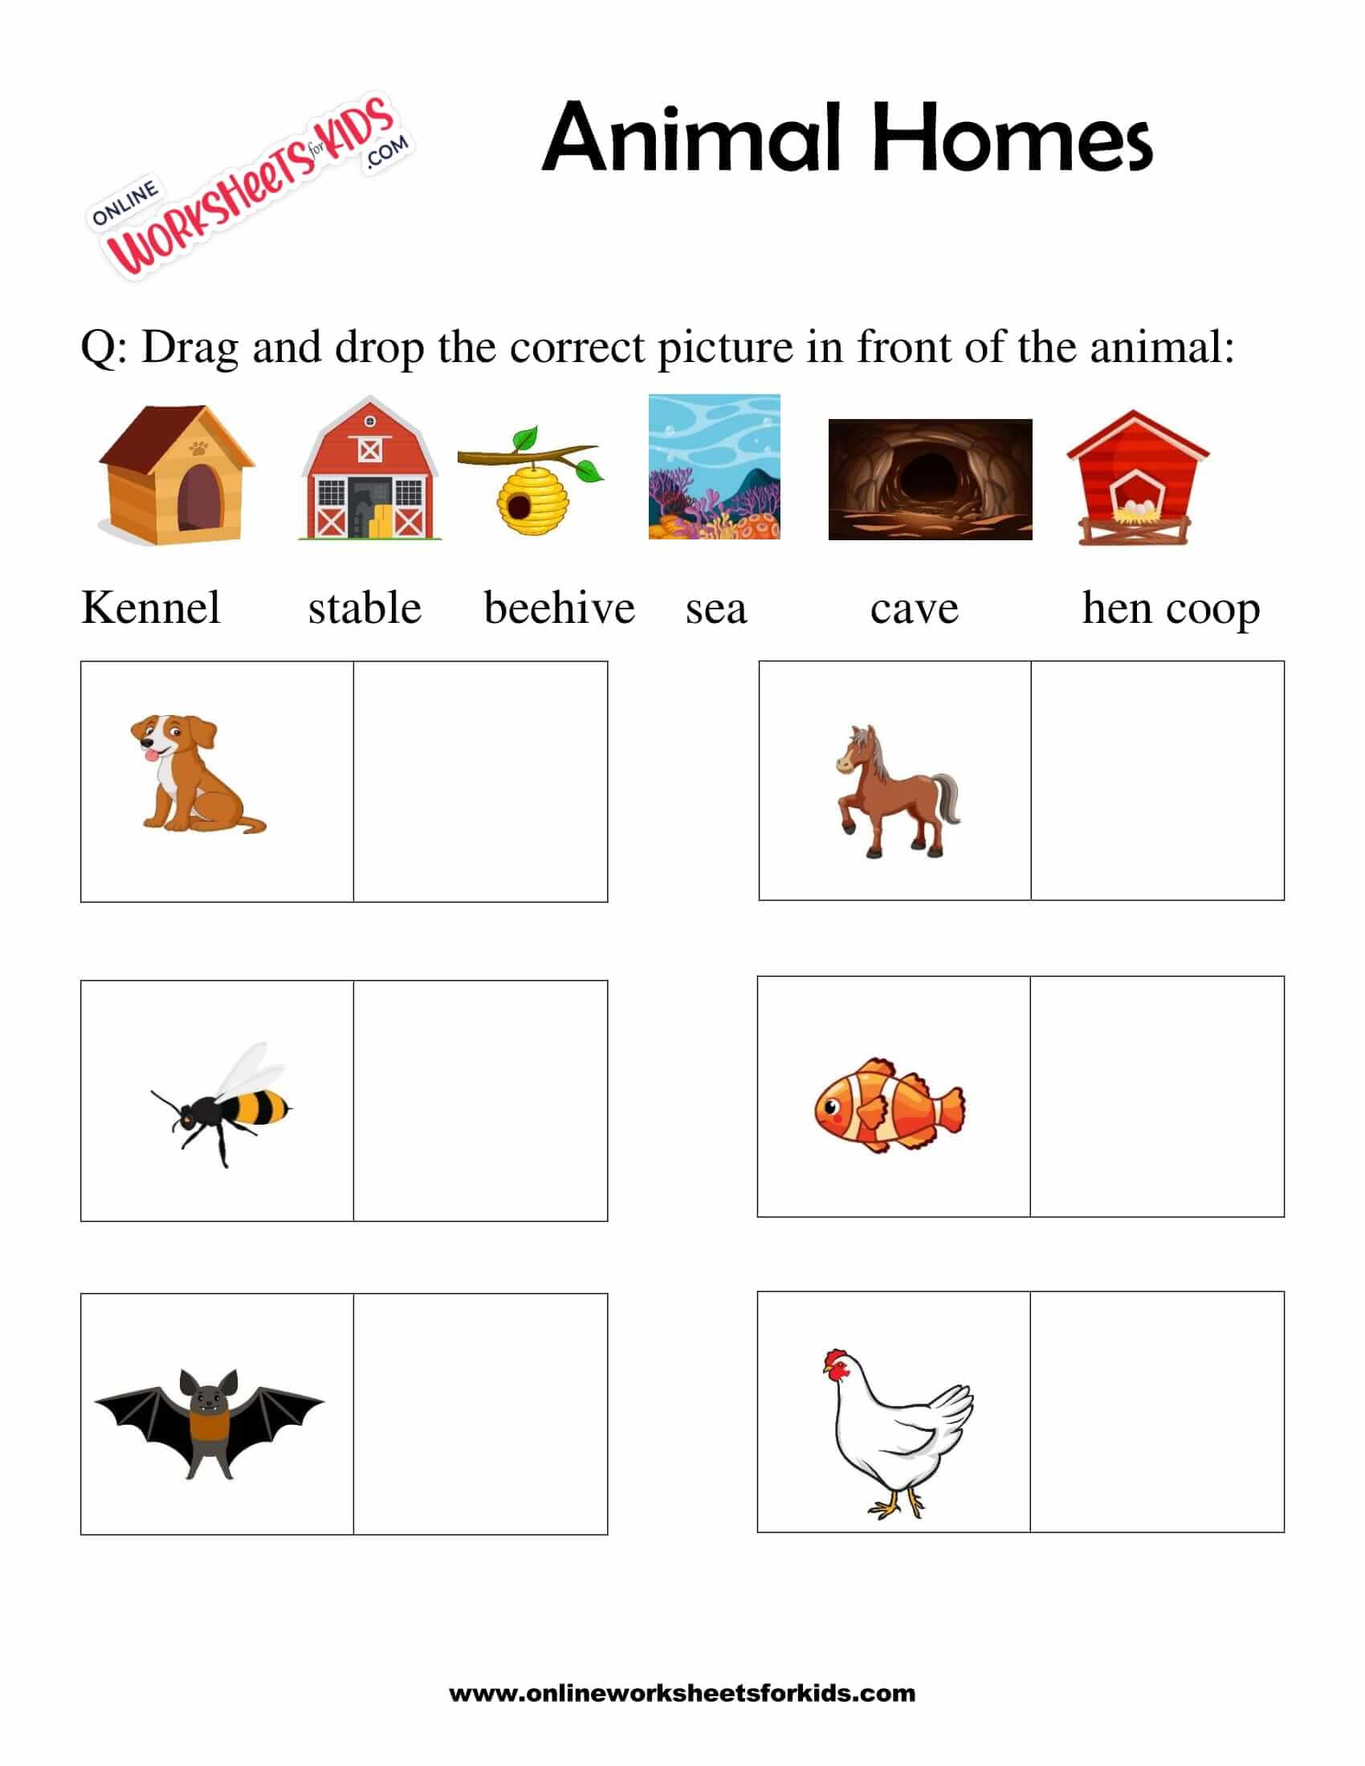
GROUP 1
Task 2: Cut and paste each animal home in front of the animal

Slide 31
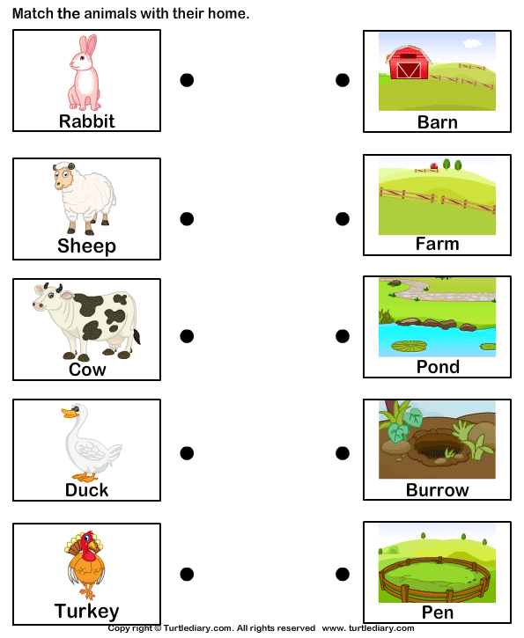

GROUP 2
Task 1: Match the images on the left with their corresponding images on the right.

Slide 32





GROUP 2
Task 2: Identify the type of animal that lives each picture below.
 |  | cave
 |  | kennel
 |  | den
 |  | pond
 |  | coop

Slide 33
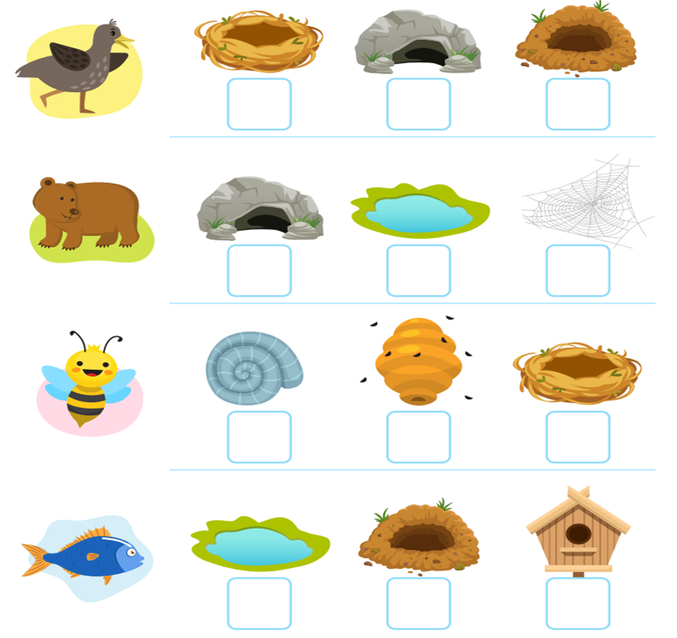
Group 3
Task 1: All living things need shelter to protect them. Tick √ the correct animal home.

Slide 34
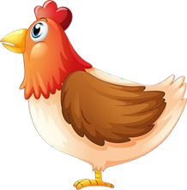





GROUP 3
chicken coop cave coral reefs spiderweb
Task 2: Write in the name of the home.

Slide 35
WEEK 8 & 9
FARM AND WILD ANIMALS

Slide 36
LESSON OBJECTIVES
Identify/name and compare different farm animals
Understand uses of farm animals such as food and clothing
Identify/name and compare wild animals
Understand the meaning of camouflage
Compare camouflage of farm and wild animals

Slide 37
ASSESSMENT GOALS
Identify/name and compare different farm animals
Understand uses of farm animals for food and clothing
Identify/name and compare wild animals

Slide 38

FARM AND WILD ANIMALS

Slide 39
GROUP 1
Task 1: Look at the picture and talk about the different farm animals you see.

Slide 40




GROUP 1
Task 2: Colour the wild animals below.

Slide 41
GROUP 2
Task 1: Match the pictures to the word.

Slide 42





Group 2
Task 2: Trace the words then write in the space next t it.
 | tiger
 | Fox
 | elephant
 | lion
 | deer

Slide 43

GROUP 3
Task 1: Cut and paste the pictures below to match the animal names.

Slide 44
GROUP 3
Task 2: Identify and label the pictures of the farm animals below.

Slide 45
Task 1: cont.…
dog horse pig chicken duck cow donkey sheep goat

Slide 46
Resources
www.k5learning.com
www. sparklebox.co.uk
www.twinkl.co.za
www.Pinterest.com

